Slide 1
Data Files, File Groups & TempDB - باللغة العربية
Ayman El-Ghazali

Slide 2
Agenda
Data Files
File Groups
TempDB
Instant File Initialization

Slide 3
Data Files
Stores data from tables and indexes in pages
File extension is .Mdf for first file and .Ndf for additional files
Use separate physical disks when available/appropriate
Separate from Log and TempDB Files; consider this a requirement
Make sure Data files are equally sized
Make sure that you pre-size your data files in advance

Slide 4
File Groups
Logical Container for Database Files
Allows for separation of data and indexes
Used for Table Partitioning
Primary File Group
File Group 2
DataFile1.Mdf
DataFile2.Ndf
DataFile3.Ndf
DataFile4.Ndf

Slide 5
Files Files Files & FileGroups
Modern DBMS has multi-threading capabilities
The DB Engine can take advantage of this to allow multiple working processes to use one or more threads to complete work
File placement, size, and number can make or break performance
Data/Indexes can be distributed across different File Groups as well
Round Robin Proportional Fill-Algorithm (by File Group)

Slide 6
Round Robin Proportional Fill Algorithm
Record1
Record3
Record1
Record3
Record2
Record4
Record2
Record4
1GB
100% Free
500MB
100% Free
500MB
100% Free
500MB
100% Free
*SQL 2016: Trace flag 1117 is replaced by the AUTOGROW_SINGLE_FILE and AUTOGROW_ALL_FILES

Slide 7
TempDB – Server’s Community Pool
Multiple files allow for multiple threads to use TempDB
Reduces “System” Page Contention (GAM, SGAM, PFS)
These internal pages help SQL Server allocate/track space for objects such as tables. Therefore when contention is reduced, performance is increased.
Start with 4-8 files, do not exceed 8 unless needed
Pre-size them equally according to your workload
TEST TEST TEST

Slide 8
Demo
Data Files, File Groups and TempDB

Slide 9
Instant File Initialization - IFI
What is it?
Prevents database files from “Zeroing Out” or “Zero-Filling” upon creation and growth

Slide 10
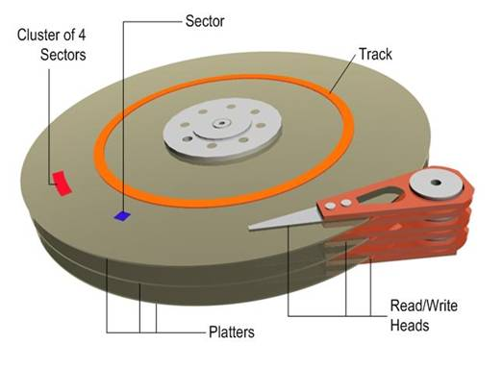
File Deletion vs. File Erasure
00000000000000000000000000000000
“Available”
Image source: http://i.technet.microsoft.com/dynimg/IC306536.jpg

Slide 11
IFI Off vs IFI On
000000000000000000000
00000000000000

Slide 12
Why is it useful?
Makes Database file creation and growth faster
Creating database files faster means that rebuilding TempDB is faster
Occurs with Server restart or SQL Services restarting, potentially speeding up Cluster failovers
Who doesn’t want a performance boost?
Does not affect Log Files, only applies to Data files
Does not work with databases that use Transparent Data Encryption (TDE) and a few other rules

Slide 13
How do you set it up?
Two ways:
The Crazy way – by adding the SQL Server service as an admin on the server. Works but is dangerous!
The Right way – by adding the SQL Server service to the “Perform volume maintenance tasks” security policy
Can be found under Control Panel>Administrative Tools>Local Security Policy
Under Local Policies>User Rights Assignment>Perform Volume Maintenance Tasks
Use Trace Flag 3004 and 3605 to test
3004 shows backup and file creation info; 3605 writes it to the SQL Server Log
DBCC TRACEON (3004,3605,-1)
EXEC sp_readerrorlog – Use this command to read the error log

Slide 14
Demo
Instant File Initialization

